Slide 1
Report on activities of the Forum of SAIs with jurisdictional functions
Meeting of KSC - SC Manilla – June 2019
Rémi Frentz Head of International relations Department Cour des comptes – SAI France

Slide 2
37 Members of the Forum of Jurisdictional SAIs
In 2019 the Forum counts:
30 members
7 observers
This network continues to expend, especially toward non jurisdictional SAIs interested in those activities.
.

Slide 3
Activities of the Forum
1
2
3
October 2017: Meeting of the working group in Marrakech on the basis of a first working document.
January 2017: creation of a working group on standardization of jurisdictional (SAIs of Brazil, Chile, Ecuador, France, Greece, Italy, Morocco, Peru, Portugal, Senegal, Spain, Togo and Turkey).
4
July 2018: Plenary meeting of the Forum in in Santiago de Chile; endorsement of a draft “Principles of jurisdictional activities of SAIs”.
November 2015: First meeting of the Forum of SAIs with jurisdictional functions in Paris; drafting of the Paris Declaration.
December 2016: Plenary meeting of the Forum in Abu Dhabi. Signing of the Paris Declaration.
5
January 2019: technical meeting of the Forum in Istanbul, to discuss the tools to fight against corruption in the context of a jurisdictional SAI.

Slide 4
Activity 1 of the Forum: Drafting a professional pronouncement of jurisdictional activities of SAIs
Motives for this work
It is not included in the IFPP
It is a core, structural and historical mission of SAIs
25% of SAIs undertake jurisdictional activities
Reason 1 Recognition for the specific activities to make the ISSAIs “the preferred solution for INTOSAI’s members”
Reason 3 Ensuring homogeneous practices
and methods amidst SAIs
Reason 4 Better understanding in capacity-building programs (SAI PMF, Competency framework)
Reason 2 Providing an international recognized basis for SAIs wishing to add those missions to their mandate

Slide 5
Motive for this work: the « missing pieces »
Jurisdictional control of accounts
INTOSAI - P
Feeds
Jurisdictional activities
ISSAI 100
ISSAI 200, 2000,….
ISSAI 300, 3000,….
ISSAI 400, 4000,….
Feeds
External information
Feeds
Leads to
Jurisdictional decisions
Audit reports

Slide 6
What are SAIs jurisdictional activities?
Audit reports
Jurisdictional control
External information
THE 12 PRINCIPLES OF JURISDICTIONAL COMPETENCES
Responsibility regime
Investigation
Freedom to access information
Independence of the Court members
Statute of limitations
Public Prosecutor’s Office
Reasonable period
Judgement process
Right to a fair trial
Quality control
Existence of remedies
Impartial judgement
Jurisdictional decision
Communication to the public
Non accumulation of sanction
Effectiveness of the decision
Sanction

Slide 7
Drafting the document: relationship with the FIPP
July / November 2017: FIPP inclusion for inclusion as a GUID of the project in the INTOSAI IFPP SDP (2017/2019).
March 2018: FIPP meeting in Paris - Presentation of a justification statement with new consideration on the status of the document (ISSAI or GUID).
June 2017: Project proposal submitted to PSC, KSC, and FIPP
August 2018 : Agreement of the FIPP on the revised project proposal as either an ISSAI or an INTOSAI-P (see PSC chair report to Governing board)
November 2018: Approval of the project proposal and of the classification of the project as a future INTOSAI Core Principle – INTOSAI P
March 2019 : Revision / approval by FIPP of the exposure draft as INTOSAI P-50
June 2019: Revision of the endorsment version of the document

Slide 8
Drafting of the document: last 2018 KSC SC meeting
KSC SC – Kampala – August 20 to 22:
Support to classify the document as an ISSAI or INTOSAI P and not a GUID; decision transmitted to the FIPP Chair;
Support of the justification statement and project proposal with some suggested amendments.

Slide 9
Next steps for the INTOSAI P – 50
1
2
September 2019: Endorsement of the “INTOSAI P-50 : Principals of jurisdictional activities of SAIs ” by the XXIII INCOSAI in Moscow
March to June (17th) 2019 : Exposure period of the document
July - August 2019: Drafting and translation of the endorsement version of the document
3
June 12 to 14: Presentation of the document to the KSC SC
June 24 to 28: Examination by the FIPP of the endorsment version
Very tight schedule!

Slide 10
Activity 2 of the Forum: The Task force on auditors professionalisation
Upon request from the Office of the Auditor general of South Africa, chairing the CBC Task Force on INTOSAI Auditor Professionalization (TFIAP) :
the Forum took part to the project “Auditor competency framework”, in order to draft its part related to jurisdictional activities.
SAI Senegal was the leader on the jurisdictional work stream
SAI France attended 2 of the meetings of the TFIAP (Stockholm 2018, Vienna 2019)
SAI South Africa presented the result of their work to the plenary meeting of the Forum in Santiago de Chile, July 2018.

Slide 11
Activity 3 : providing jurisdictional SAIs point of view in the other INTOSAI WG
Upon request of various other INTOSAI Working groups,
the Forum is regularly consulted to provide Jurisdictional point of view on various matters, essentially in terms of Professional pronouncements (ie public procurement, CAS/FAAS/ PAS guidelines).

Slide 12
Next steps for the Forum?
INCOSAI XXIII in Moscow:
Plenary meeting of the Forum in the margins of the Congress
Endorsement of the 2020/2022 work plan of the Forum

Slide 13
Establishing the 2020/2022 work plan
Methodology
Discussion on the lines of action in the January 2019 meeting of the Forum
Dissemination of a survey to the members to chose the lines of work
Dissemination of a draft work plan
Present this work plan during the INCOSAI XXIII

Slide 14
Establishing the 2020/2022 work plan
Main activities considered
Developing an IFPP guidance (GUID 5xxx) based on the INTOSAI – P 50 and adapted to specific jurisdictional sub-models – to be presented in INCOSAI XXIV in 2022
Professional seminars
Support to SAIs willing to
get
recover
strengthen
jurisdictional activities

Slide 15
A booth at the next INCOSAI for the Forum of Jurisdictional SAIs
The INTOSAI Chair and GS proposed the Forum to have a booth to present our activities. The Forum has agreed to undertake this activity.
We will also participate to the KSC Booth

Slide 16
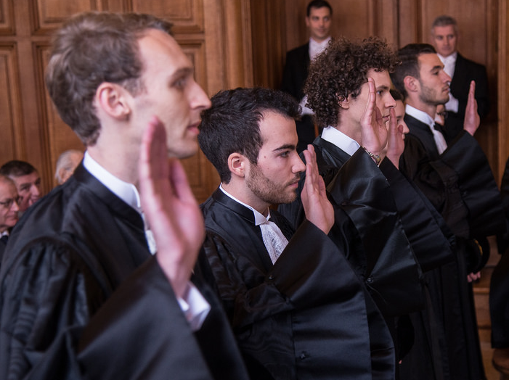
Thank you for your attention …

